Slide 1

Presented by group 6 Shreya Sheelvant Nimisha P J Ankita Shelar G. Devi Priya
HR ANALYTICS

Slide 2
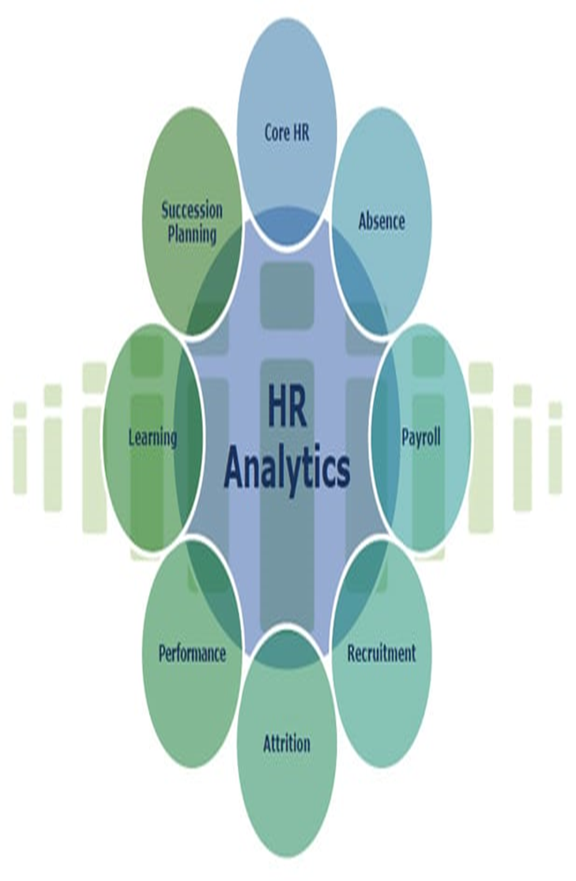
Definition:
A systematic identification and analysis of the people drivers of any specific business outcome.
Leveraging Data for Strategic HR Decision-Making

Slide 3

Same or Different?
WORKFORCE ANALYTICS
HR ANALYTICS
PEOPLE ANALYTICS
TALENT ANALYTICS

Slide 4




Tools used
EXCEL
Power Bi
Tableau
My SQL

Slide 5
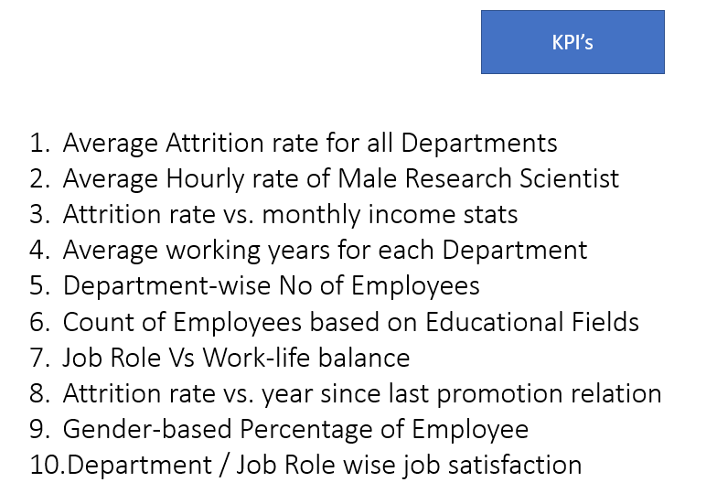
FILES & KPI’s

Slide 6
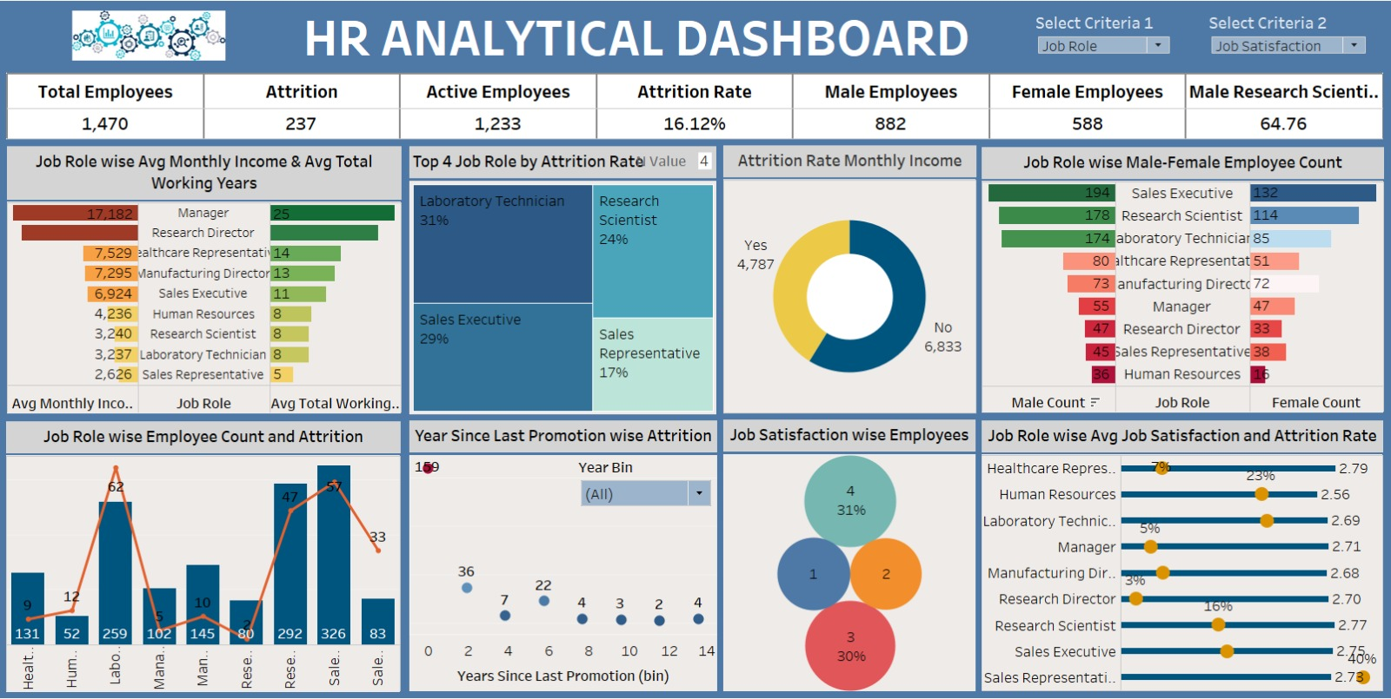
HR Analytics Dashboard

Slide 7
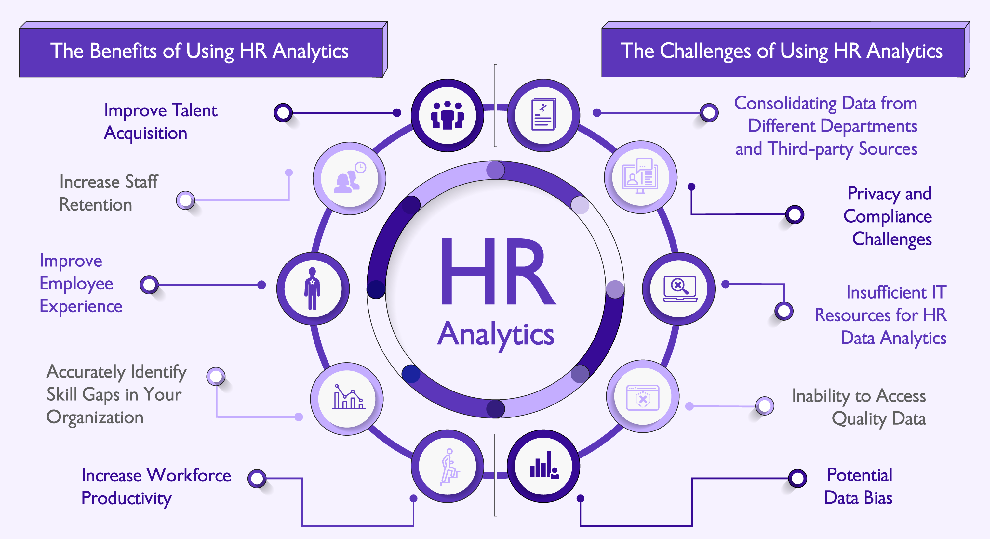
Pros and Cons of HR Analytics

Slide 8
RECOMMENDATION
Employee Demographics and HR Metrics
Employee Surveys and Feedback
Performance Metrics
Recruitment and Hiring Data
External Benchmarks and Industry Trends
Workforce Planning
Compliance and Legal Data
Employee Wellness and Health Data

Slide 9


ACKNOWLEDGMENT

Slide 10


